Slide 1
Vessel Extraction in X-Ray Angiograms Using Deep Learning
Ziyan Li
Nasr-Esfahani E, Samavi S, Karimi N, et al. Vessel extraction in X-ray angiograms using deep learning[C]//Engineering in Medicine and Biology Society (EMBC), 2016 IEEE 38th Annual International Conference of the. IEEE, 2016: 643-646.

Slide 2
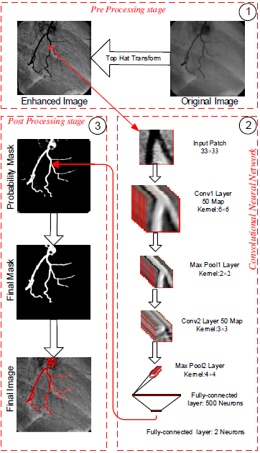
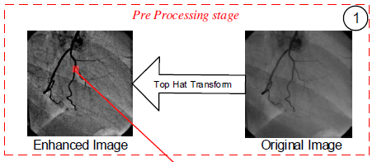
Overview
Vessel extraction：deep CNN
Preprocess：top-hat transform
WTH and BTH
Extract small elements

Slide 3
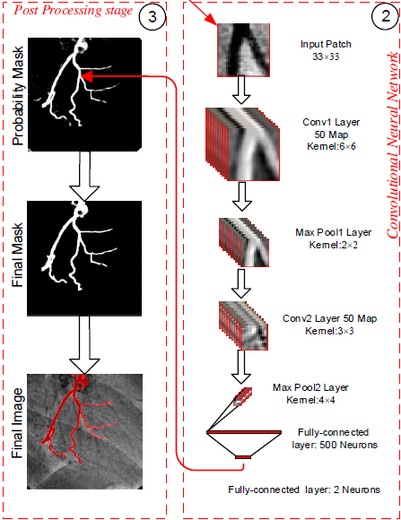
CNN Architecture
input image：patch
(33*33, 1040000 patches)
architecture：
two convolve layers(depth 50)
two max pooling layers
two fully connected layers
output：
two probabilities for the
center pixel of the patch
(vessel region and background)

Slide 4
Results
Get binary mask：threshold T
Dataset：44 X-ray images (resolution of 512*512)
Train:26
Test:18
The ratio of foreground and background: 1：1
Metrics：
accuracy,sensitivity,specificity,PPV(阳性预测率)，NPV

Slide 5
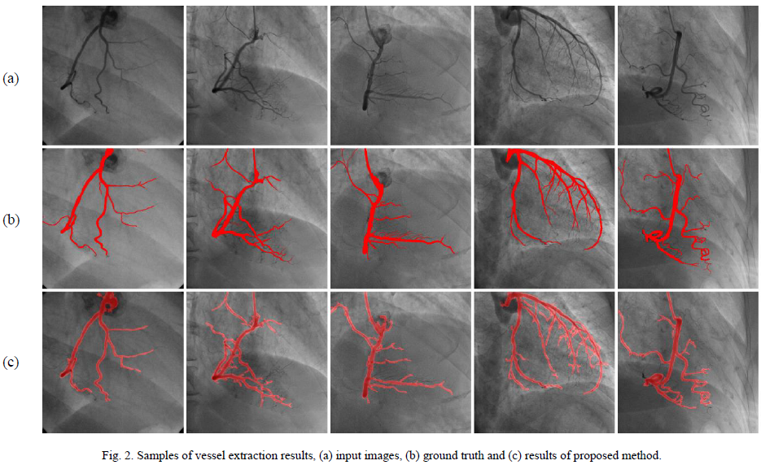
Results

Slide 6
From Captions to Visual Concepts and Back
Fang H, Gupta S, Iandola F, et al. From captions to visual concepts and back[C]//Proceedings of the IEEE Conference on Computer Vision and Pattern Recognition. 2015: 1473-1482.

Slide 7
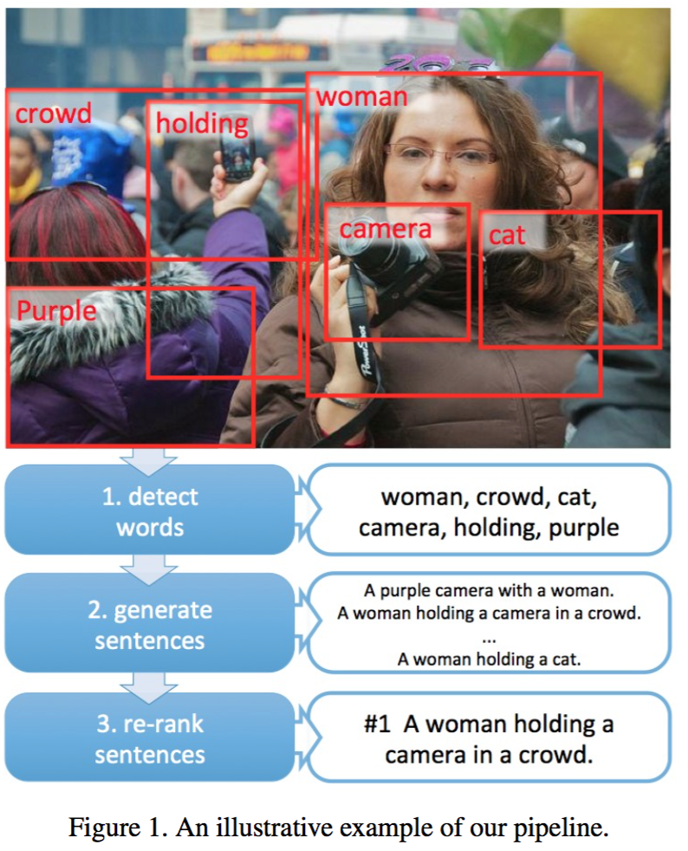
Overview
Main approaches：retrieval of existing human-written captions, and generation of novel captions
Caption Generation Pipeline
Detect words
Generate sentences
Re-rank sentences

Slide 8
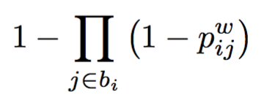
Word Detection
Training Word Detectors
Vocabulary ：1000 most common words in the training captions
Train detectors：
Not standard supervised learning：no words bounding boxes
Weakly-supervised approach of Multiple Instance Learning (多示例学习)
Compute $p_{ij}^{ω}$ ：a logistic function on top of the fc7 layer
The probability of word $ω$ in bag $b_{i}$
Notes:
bounding boxes may not be easily defined, such as open or beautiful
每张图像即一个bag，图像中的patch就是示例，单词w出现在图像的标注中，图像 i 就标记为正；
单词使用one-hot编码

Slide 9
Word Detection
Get coarse spatial response map
Each location expresses the $p_{ij}^{ω}$
MIL：$p_{ij}^{ω}—>p_{i}^{ω}$
Generating Word Scores for a Test Image
for all words $ω$ in the vocabulary, put the image into CNN to obtain $p_{i}^{ω}$
Output all words $ω$ if $p_{i}^{ω}>threshold τ$
Notes:
bounding boxes may not be easily defined, such as open or beautiful
每张图像即一个bag，图像中的patch就是示例，单词w出现在图像的标注中，图像 i 就标记为正；
单词使用one-hot编码

Slide 10
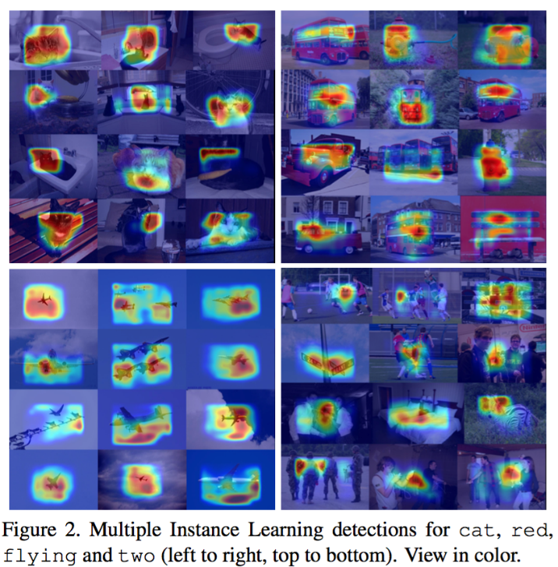
Word Detection
Generating Word Scores for a Test Image

Slide 11
Language Generation
To generate candidate captions, we use a maximum entropy (ME) LM conditioned on the set of visually detected words
objective function of MELM: log likelihood of the of the captions
Notes:
where <s> denotes the start-of-sentence token, ¯ wj 2 V [
</s>, and fk(wl, · · · , w1, ˜Vl−1) and #k respectively denote
the k-th max-entropy feature and its weight

Slide 12
Language Generation
Generation Process
Beam Search(束搜索)
When </s>（the end of sentence token） is generated， the full path to </s> is removed from the stack and set aside as a completed sentence. The process continues until a maximum sentence length L is reached
Choose M-best sentences
Given a target number of T image attributes to be mentioned, the sequences in C covering at least T objects are added to the M-best list, sorted in descending order by the log-likelihood.
Notes:
This maintains a stack of length l

Slide 13
Sentence Re-Ranking
Use MERT(最小错误率训练法) to re-rank the M sentences
uses a linear combination of features
a new feature: DMSM（多模态相似模型）
Deep Multimodal Similarity Model
image model
text model
learn two neural networks, map image and text to vectors
measure cosine similarity
Notes:
1. The log-likelihood of the sequence. 2. The length of the sequence. 3. The log-probability per word of the sequence. 4. The logarithm of the sequence’s rank in the log-likelihood. 5. 11 binary features indicating whether the number
of mentioned objects is x (x = 0,...,10). 6. The DMSM score between the sequence and the image.

Slide 14
Results
Datasets 1：Microsoft COCO dataset
82783 training images
40504 validation images
PPLX、BLEU、METEOR
Notes:
PPLX (perplexity) measures the uncertainty of the language model
METEOR measures unigram precision and re- call
Uncon- ditioned, which generates sentences by sampling an N- gram LM without knowledge of the visual word detectors;
and Shuffled Human, which randomly picks another human generated caption from another image.
Both the BLEU and METEOR scores are very low for these ap- proaches, demonstrating the variation and complexity of the Microsoft COCO dataset.

